Slide 1



AUTONOMOUS
INSIGHTS
autoinsights@ai.co.za
Notes:
Add team/company logo
Can you guys choose which one you like so we can decide which one to put.

Slide 2

0UTLINE
WHO WE ARE
PROJECT BRIEF
EXPLORATORY DATA ANALYSIS
FEATURE ENGINEERING
DATA MODELLING
APP DEMONSTRATION
BENEFITS
KEY INSIGHTS
CONCLUSION
Notes:
Change the image to ours/something related to our company

Slide 3
AUTONOMOUS INSIGHTS

Slide 4

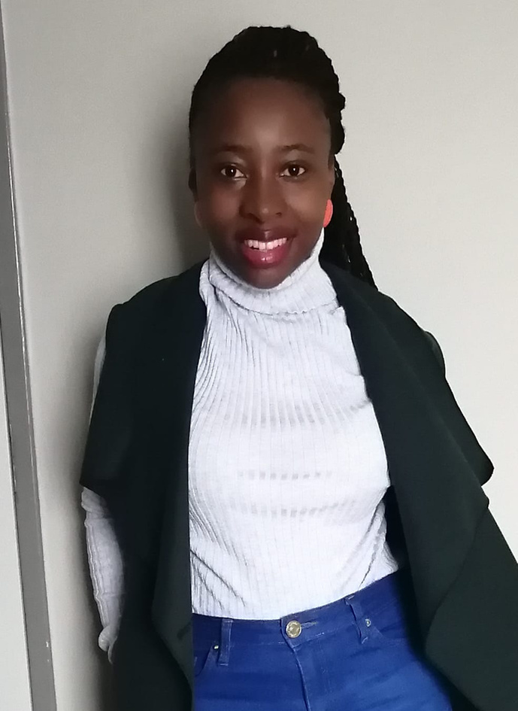






OUR TEAM
HARMONY MNCUBE
PHINDULO TSHIVHILINGE
YVONNE MALINGA
KGOPOTSO TLAKA
LESEGO PRECIOUS SEFIKE
NDUMISO NKOSI
LEHLOHONOLO RADEBE
EMMANUEL NKOSI

Slide 5




INTRODUCTION
INTERNATIONAL STREAMING PLATFORMS

Slide 6




INTRODUCTION
SOUTH AFRICAN STREAMING PLATFORMS
Notes:
Change the image to ours/something related to our company

Slide 7


CLIENT: VIU

Slide 8
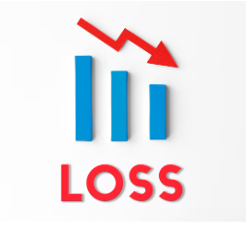
CLIENT: VIU
Notes:
Team comment: Problem statement should reflect our storyline
The problem statement or story line here is about VIU
side notes: Viu a streaming company has approached us to help them increase their viewership, the company's main content in South Africa is soapies and series, but they would like to venture into movies and has approached us to develop an app that will be able to recommend a movie based on the customer's preference.

Slide 9

SOLUTION CONSTRUCTION

Slide 10



EXPLORATORY DATA ANALYSIS (EDA)

Slide 11


DESCRIPTION OF FEATURES
Content Based Filtering Features
Title
Genres
Runtime
Keywords
Collaborative Filtering Features
Timestamp
Metadata Features
Year
Budget
Director
Cast
Identification Features
IMDb ID
Movie ID

Slide 12
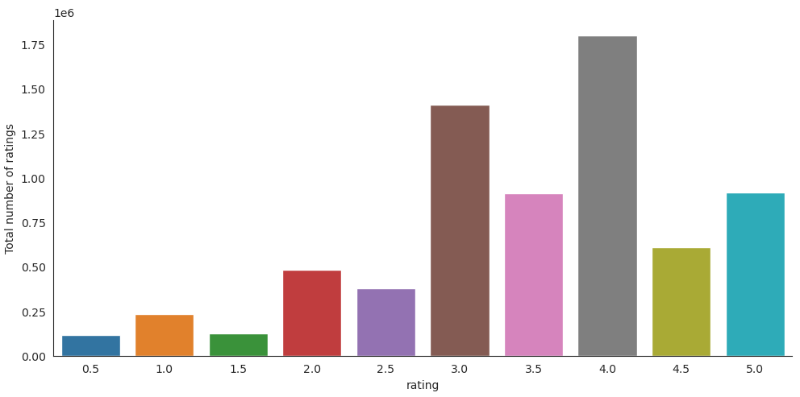
TARGET VARIABLE (RATINGS)

Slide 13
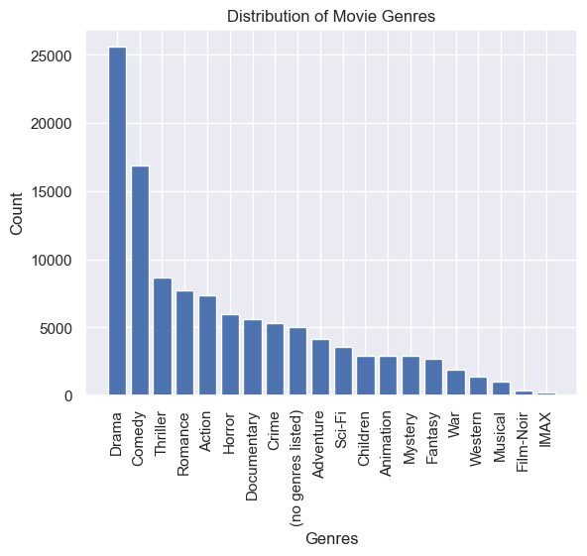
MOVIE GENRE DISTRIBUTION

Slide 14
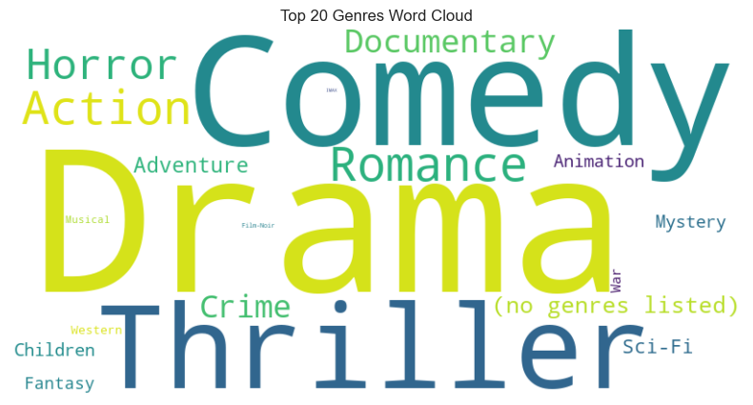
WORLD'S MOST POPULAR GENRES

Slide 15

FEATURE ENGINEERING
Numeric
23.1%
KEY FEATURES
FEATURE TRANSFORMATIONS
TEXTUAL DATA HANDLING
Text
76.9%
Notes:
We converted some of the features, such as tags and their relevance, by processing the text data. This approach was taken to mitigate the computationally expensive and slow training processes. By converting the text data into more efficient representations, we optimized the training and avoided unnecessary overhead, resulting in faster and more efficient training without compromising on important information.
To avoid issues such as data leakage, incorrect scaling, and overfitting, it was essential for us to ensure proper data preprocessing. We focused on cleaning and organizing the data before using it for training. We employed appropriate scaling techniques to standardize or normalize the numerical features, ensuring they were on the same scale. Additionally, we handled missing values and outliers in a sensible manner to prevent distortions in the data. By implementing these steps diligently, we enhanced the reliability and performance of our machine learning models.

Slide 16

Data Engineering
NEW FEATURE GENERATION
USER-SPECIFIC FEATURES
CROSS-FEATURING
Notes:
we focused on three key aspects for feature engineering: popularity score, average rating, and rating spread. We also personalized genre preferences and measured user activity. By combining these features and analyzing genre-director interactions, we were able to improve the performance and personalization of the movie recommendation system. Engineered features played a crucial role as inputs for recommendation algorithms, ultimately enhancing the user experience. The use of effective feature engineering proved to be instrumental in achieving better results for the movie recommendation system.

Slide 17

BUILD THE RECOMMENDATION MODEL
MODELLING TECHNIQUE
RECOMMENDATION ENGINE
SUGGESTIONS BASED
REAL-TIME RESPONSE

Slide 18
RECOMMENDATION ENGINE - THE POWER BEHIND OUR APP
PERSONALIZED RECOMMENDATIONS
CONTENT-BASED FILTERING
COLLABORATIVE FILTERING

Slide 19
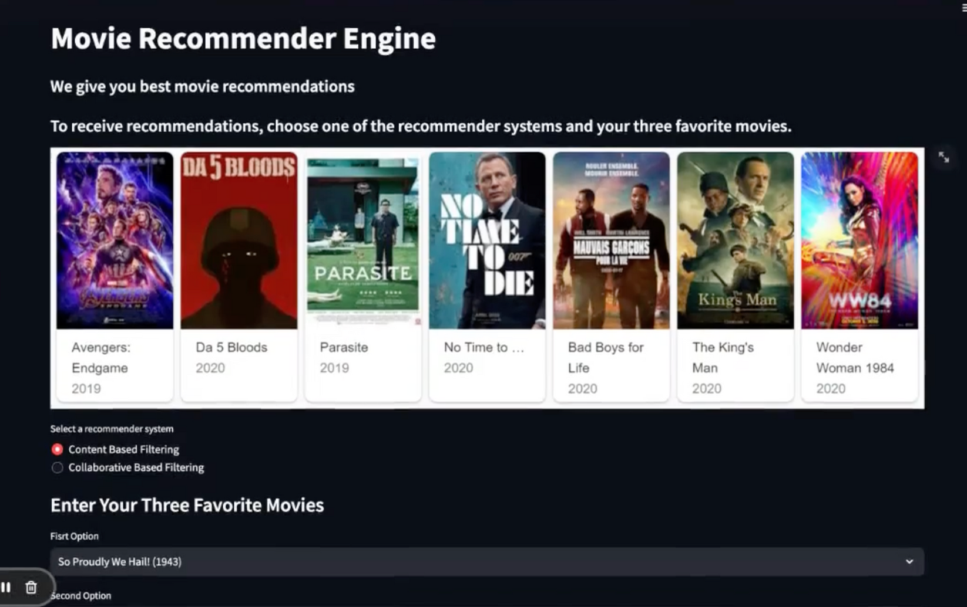
APP DEMOSTRATION
VISIT THE LINK TO TRY OUR RECOMMENDER ENGINE
HTTPS://AUTONOMOVIES.STREAMLIT.APP/

Slide 20
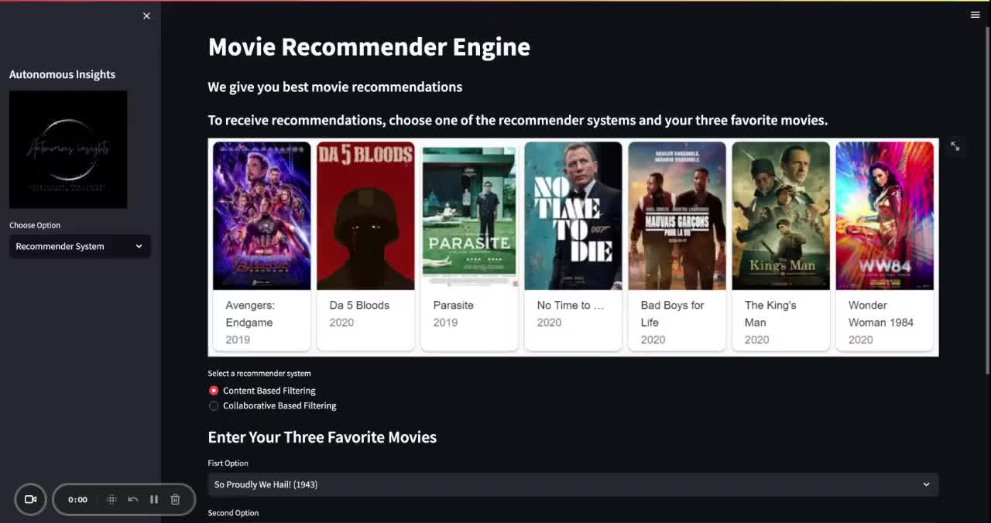
Notes:
Play the video for 1.5 minutes

Slide 21
BENEFITS
Increases customer's satisfaction
Increase sales.
Increases customer's engagement
Brings in new customers.
Notes:
Side notes:
It increases customer's satisfaction, increases customer's engagement, attracting new customers to use the platform which in turn increases the sales for the company.

Slide 22
KEY INSIGHTS
What we learnt
Unique Ratings
Investigating users and distribution of genres.
Diversity of the data
Recommendation Function
SVD Model

Slide 23
CONCLUSION
QUESTIONS?

Slide 24

LET'S CONNECT WITH US!
+123-456-7890
autoinsights@ai.co.za
www.autoinsights.com

